Slide 1


A Child of Promise
The Work of Sister Sandra and Project Reflect

Slide 2
Missions
Catholic Business League
Project Reflect
The mission of the Catholic Business League is to connect, develop, and inspire Catholic professionals to live their faith at work, at home, and in their community.
Our mission is to transform communities through education.
Living our faith in our organizations connects us…

Slide 3
Our talk today…
I’m going to talk about how faith is a cornerstone of our organization as evidenced by the actions and life of our founder, Sister Sandra Smithson.
I’m going to do it with four numbers, spanning a century:
1932
1992
2002
2022

Slide 4
1932
Our founder as a child….

Slide 5
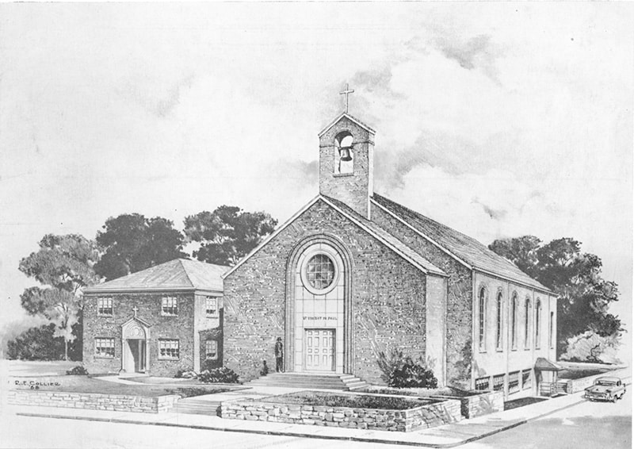
1932: Rooted in faith , transformation, and reform.
St Vincent De Paul school was established in 1932 by St. Katharine Drexel and the Sisters of the Blessed Sacrament to serve African-American families in North Nashville.
It provided one of the few high-quality private Catholic educational options available to Black children in Nashville during an era of strict racial segregation and underfunded public schools for African Americans.
5 year old Sandra Smithson was one of the first kindergarten students to enroll.

Slide 6
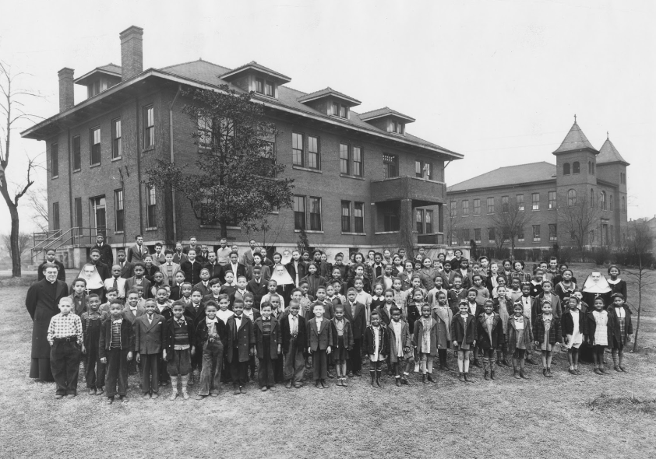
1930s and 1940s
Catholic School Education in Segregated Nashville
Attended schools founded by St. Katharine Drexel
Excelled in academics, sports, and leadership
Inspired her lifelong vocation and commitment to educational equity

Slide 7
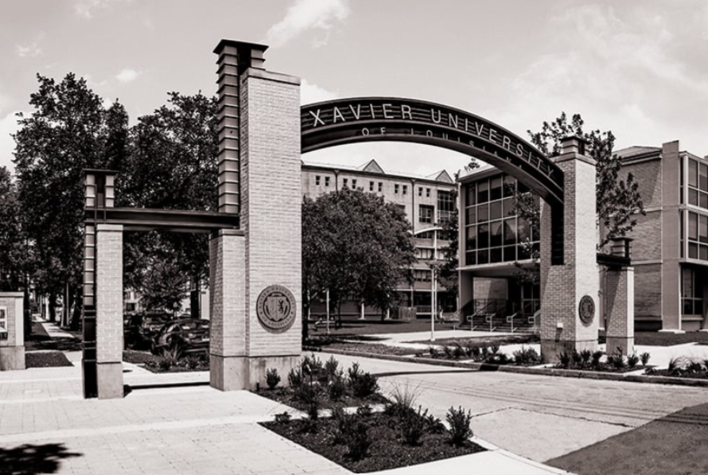
Late 1940s-50s
Higher Education & Early Career
Xavier University of Louisiana
  Nation’s only historically Black Catholic university at the time
  Graduated with honors
Returned to Nashville
  Teaching fellowship at Fisk University → Master’s in literature
Pioneering media role
  First woman to host a talk show on Nashville’s first Black radio station, WSOK
  Program title: “A Woman Speaks”

Slide 8
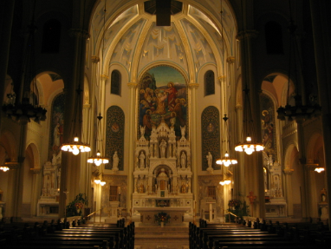
1953
March 1953
Felt a strong call to religious life
Chose the School Sisters of St. Francis
One of the few orders accepting African American women at the time
Had faced rejection from other communities due to race
September 1953
Left her job and possessions
Entered the novitiate in Milwaukee, Wisconsin

Slide 9
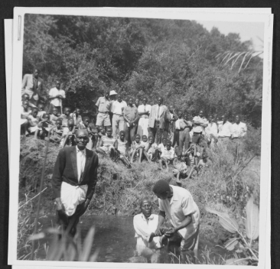
International Ministry – 1960s–Early 70s
Served in Central and South America
12 years overseeing education initiatives in Costa Rica
Also served in Honduras
Work focused on:
Educational reform
Service to the poor
Community development

Slide 10
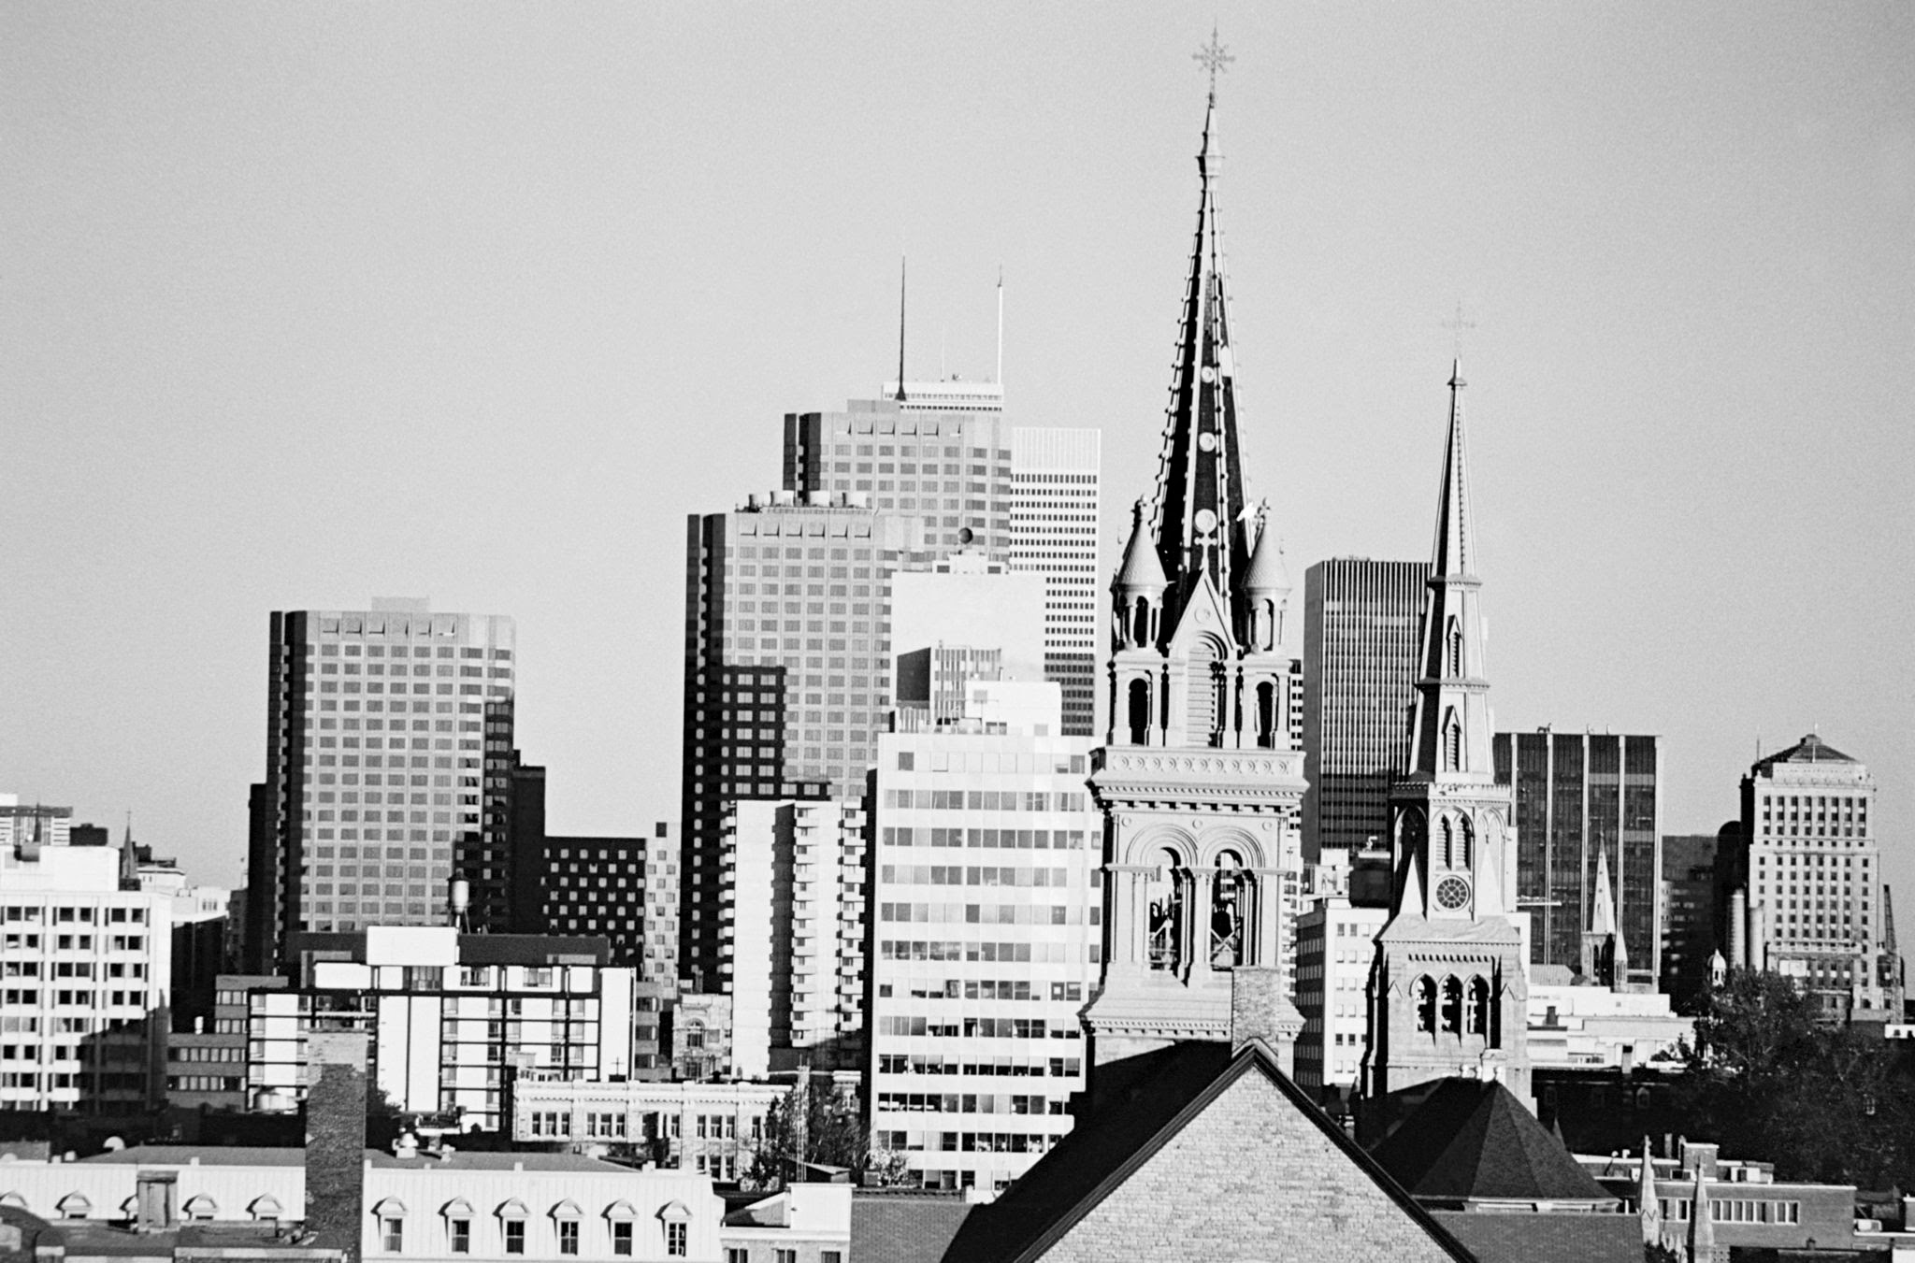
Return & Home Ministry – 1970s–1980s
1970s
Returned to Milwaukee for a period
1980s
Returned to her home neighborhood in South Nashville
Continued ministry focused on:
The poor
Education
Community upliftment
Setting the stage for her later founding of Project Reflect (1992)

Slide 11
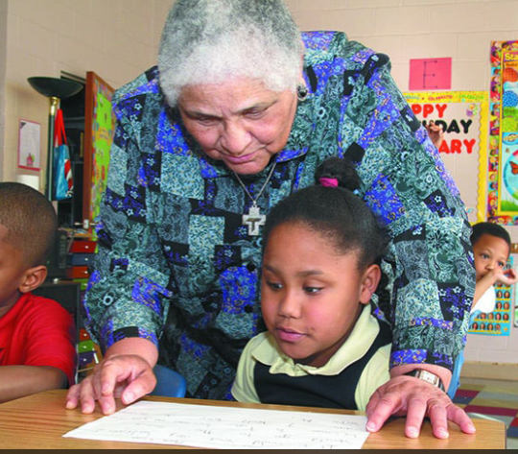
Formation of her Faith
1940s-50s
1953-54
50s-60s
60s-80s
1940s–Early 1950s: Preparation and Public Voice
1953–1954: Radical Act of Faith
1950s–1960s: Teaching as Ministry
1960s–1980s: Global and Local Service
Served over a decade in Central/South America (12 years leading education initiatives in Costa Rica + work in Honduras), then returned to South Nashville in the 1980s to minister among the poor.
→ Lived out a consistent commitment to marginalized communities worldwide and at home.
.
Heard God’s call and entered the School Sisters of St. Francis in Milwaukee in 1953 (formal reception June 13, 1954), despite racial rejection from other orders.
→ Faith as courage: Believed so strongly in God’s personal vision for her life that she left a promising career and stepped into consecrated life with unwavering trust.
Began active teaching ministry, including six years in Chicago Catholic schools, forming children and youth.
→ Faith in action: Saw education as a direct expression of Gospel love and justice, continuing the mission she first received at St. Vincent de Paul.
St. Vincent De Paul
Xavier
Radio
Latin America

Slide 12
1992
Sister Sandra’s Journey: 1992–2002
Planting Seeds of Lasting Transformation

Slide 13
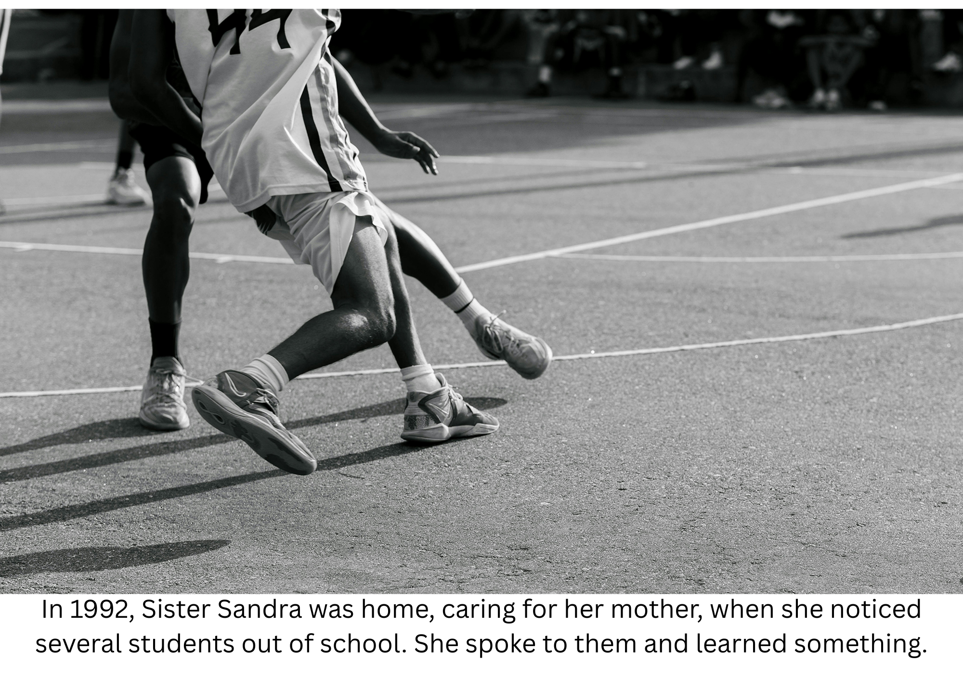

Slide 14
The students couldn’t read, thus they couldn’t do schoolwork.
Because of Sister’s efforts, all of them could read after 6-weeks.
She had the faith that they could do it, so taught them until they could.

Slide 15

1992: Founded Project Reflect
In ‘92, Sister established Project Reflect, a nonprofit dedicated to transforming communities through education, literacy, and policy reform
This set the foundation for all future initiatives.

Slide 16
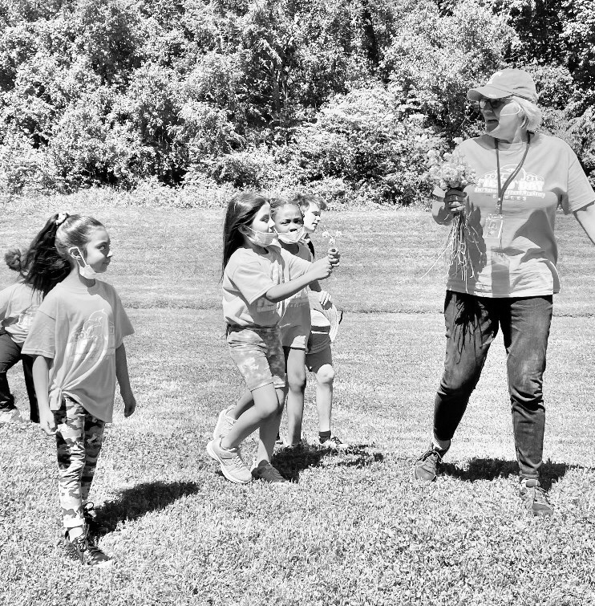
Mid-1990s: Launched after-school programming
Developed and implemented after-school programs focused on reading enrichment, homework support, character development, and safe, structured activities for children in underserved Nashville neighborhoods.
→ Extended the school day to protect and nurture children during vulnerable hours, preventing academic and social gaps.

Slide 17

1990s: Created Reading Success program
With her sister, Mary Craighead, designed the phonics-based Reading Success curriculum (later adapted into software as Reading Success in the Itty Bitty City), emphasizing early, systematic literacy to build strong, permanent reading foundations.
→ Faith in action: Believed that teaching children to read was a direct expression of Gospel justice — giving every child the dignity and power that comes from literacy.

Slide 18
2002
2002: Creative works + charter school advocacy
Bringing the Promise to Full Fruit

Slide 19
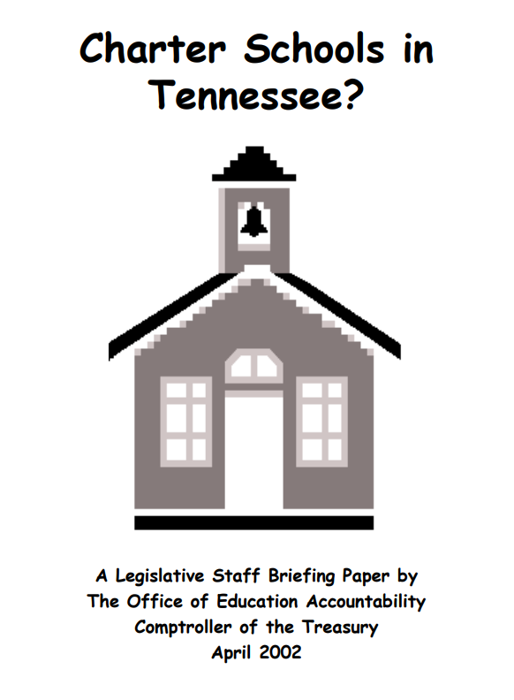
Introducing Charter Schools ….
Charter Schools are publicly funded autonomous schools with the independence to make decisions for programming, staffing models, and more.

Slide 20
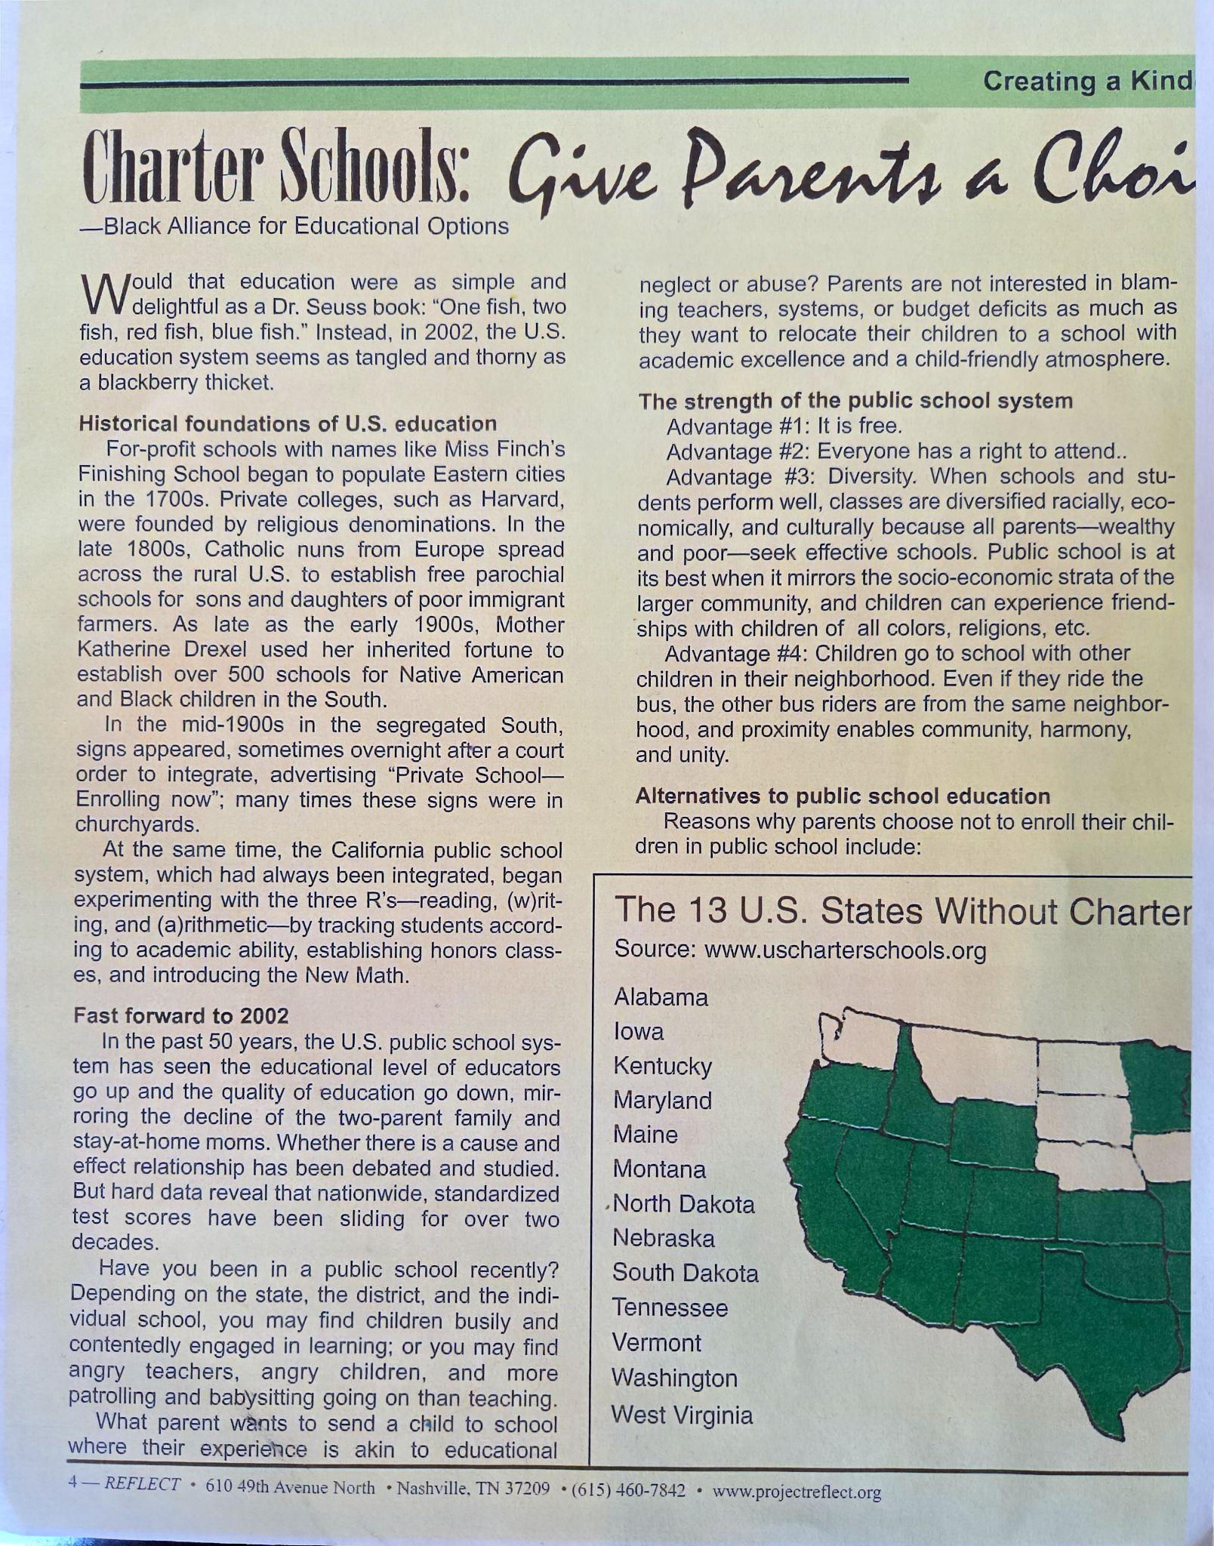
Sister Sandra saw an opportunity for the community
If TN allowed charter schools, then traditionally marginalized students would have more opportunities for high-quality education.
Sister Sandra used her platform and circulated the Project Reflect Newsletter to inform the community about the opportunities that charter schools afforded.

Slide 21
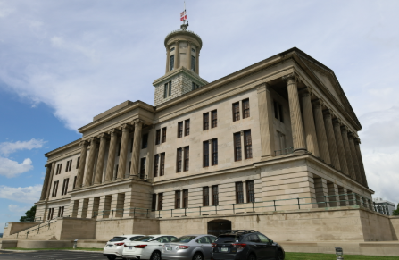
Advocacy and Legislation
Sister Sandra spent much of her time at the capitol, advocating for passage of Charter School Law.
As a result, she opened Smithson Craighead Academy with her sister, Mary Craighead.
Sister Sandra was 76 and her sister was in her early 80s.

Slide 22
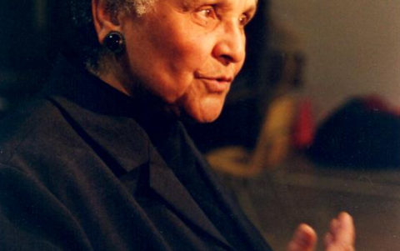
Today, there are 115 charter schools serving 44,000 Tennesseans.
Her advocacy was an act of faith.

Slide 23




Transforming Communities through Education
Smithson-Berry Educational Publishing
WRAP services
Smithson Craighead Academy K-5
Affordable to most, accessible to ALL PreK
PREP After School and Summer Programming

Slide 24
Sister retired as Executive Director in 2014 but remained actively involved in mentoring, literacy advocacy, school improvement efforts, and spiritual reflection — even into her 90s during the COVID-19 period.

Slide 25
A Child of Promise
Sister Sandra Smithson was never meant to be ordinary.
Born into a segregated Nashville that tried to limit her future,
she stepped into doors that should have been closed:
the first student at St. Vincent de Paul,
a trailblazing voice on the radio,
a religious sister in an order that welcomed her when others would not,
a founder who brought excellent education to children who needed it most.
Every chapter of her life reveals the same truth:
God placed a promise in her —
and she had the faith to believe it,
the courage to act on it,
and the perseverance to make it real for thousands of others.

Slide 26
2022
In retirement, Sister continued writing and speaking until her peaceful passing on May 13, 2022 at age 96.
In her final decade she lived the conviction that God’s promise does not fade with age; she modeled joyful perseverance, trusting that the work would continue through others.
March 3rd was officially designated as Sister Sandra Smithson Day by the State of Tennessee on March 3, 2025.

Slide 27
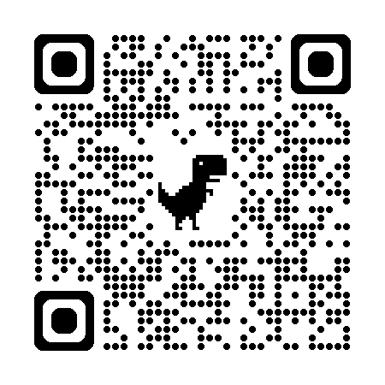
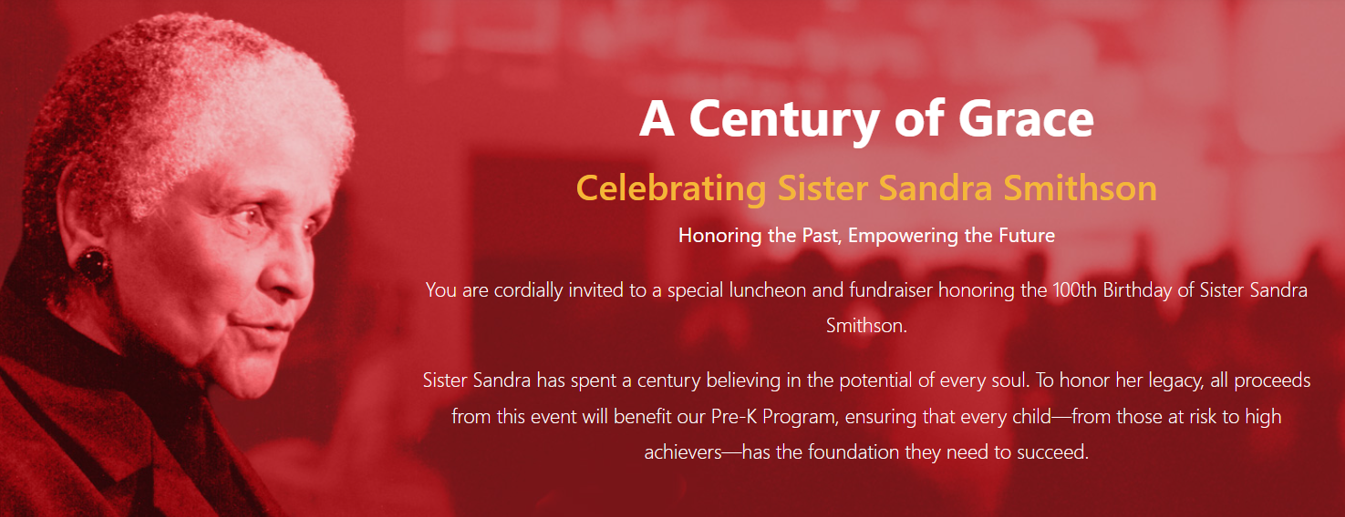
March 3rd

Slide 28
Proceeds from the ticket sales support…
Sister Sandra Memorial Fund
PK Scholarships: Our Pre-K is affordable to most, and accessible to all. At $135 per week, our PreK is among the most affordable. We also offer scholarships to families in need for up to a full year.

Slide 29

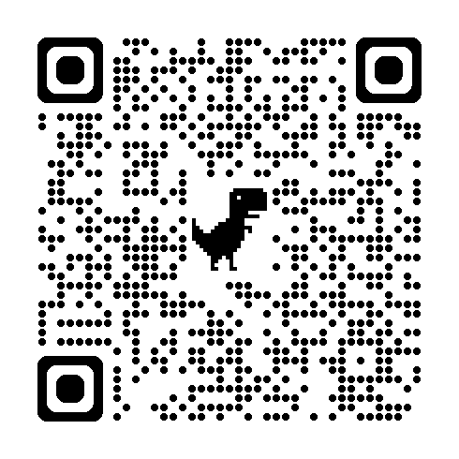
Event QR Code
Newsletter QR Code

